Slide 1

UNIT 4
Coding And Testing: Coding, Code review, Software documentation, Testing, Black-box testing, White-Box testing, Debugging, Program analysis tools, Integration testing, Testing object-oriented programs, Smoke testing, and Some general issues associated with testing.
Software Reliability and Quality Management: Software reliability. Statistical testing, Software quality, Software quality management system, ISO 9000.SEI Capability maturity model. Few other important quality standards and Six Sigma.

Slide 3
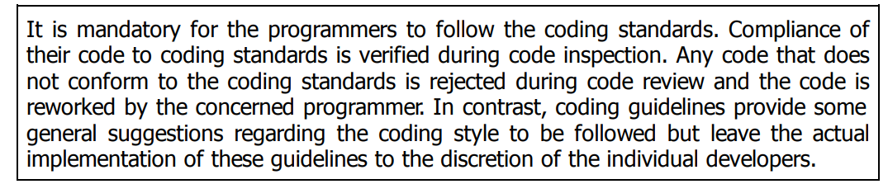
CODING

Slide 4
CODING
Coding Standards and Guidelines
we shall only list some general coding standards and guidelines that are commonly adopted by many software development organizations
1. Representative coding standards
Rules for limiting the use of globals
Standard headers for different modules
Naming conventions for global variables, local variables, and constant identifiers
2. Conventions regarding error return values and exception handling mechanisms
3. Representative coding guidelines
4. Do not use a coding style that is too clever or too difficult to understand

Slide 5
CODING
Coding Standards and Guidelines
5. Avoid obscure side effects
6. Do not use an identifier for multiple purposes
Each variable should be given a descriptive name indicating its purpose
Use of variables for multiple purposes usually makes future enhancements more difficult.
Code should be well-documented
7. Length of any function should not exceed 10 source lines
8. Do not use GO TO statements

Slide 6
CODE REVIEW
Testing is an effective defect removal mechanism. However, testing is applicable to only executable code.
Review is a very effective technique to remove defects from source code. In fact, review has been acknowledged to be more cost-effective in removing defects as compared to testing.
Code review for a module is undertaken after the module successfully compiles. That is, all the syntax errors have been eliminated from the module.
Obviously, code review does not target to design syntax errors in a program, but is designed to detect logical, algorithmic, and programming errors.
Code review has been recognised as an extremely cost-effective strategy for eliminating coding errors and for producing high quality code.

Slide 7
CODE REVIEW
Normally, the following two types of reviews are carried out on the code of a module:
Code inspection
Code walkthrough.

Slide 8
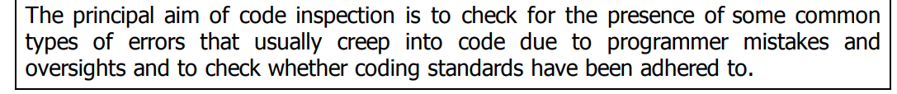
CODE REVIEW
Code inspection
Following is a list of some classical programming errors which can be checked during code inspection:
Use of uninitialised variables.
Jumps into loops.
Non-terminating loops.
Incompatible assignments.
Array indices out of bounds.
Improper storage allocation and deallocation.
Mismatch between actual and formal parameter in procedure calls.
Use of incorrect logical operators or incorrect precedence among operators.
Improper modification of loop variables.
Comparison of equality of floating point values.
Dangling reference caused when the referenced memory has not been allocated.

Slide 9
CODE REVIEW
2. Code walkthrough
Some of these guidelines are following:
The team performing code walkthrough should not be either too big or too small. Ideally, it should consist of between three to seven members.
Discussions should focus on discovery of errors and avoid deliberations on how to fix the discovered errors.
In order to foster co-operation and to avoid the feeling among the engineers that they are being watched and evaluated in the code walkthrough meetings, managers should not attend the walkthrough meetings

Slide 10
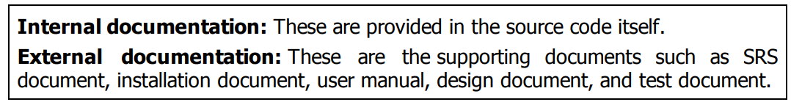
SOFTWARE DOCUMENTATION
Documents such as users’ manual, software requirements specification (SRS) document, design document, test document, installation manual, etc., are developed as part of the software engineering process.
Good documents help enhance understandability of code.
Documents help the users to understand and effectively use the system.
Good documents help to effectively tackle the manpower turnover problem.
Production of good documents helps the manager to effectively track the progress of the project.
Different types of software documents can broadly be classified into the following:

Slide 11
SOFTWARE DOCUMENTATION
Internal Documentation
Internal documentation is the code comprehension features provided in the source code itself.
The important types of internal documentation are the following:
Comments embedded in the source code.
Use of meaningful variable names.
Module and function headers.
Code indentation
Code structuring (i.e., code decomposed into modules and functions).
Use of constant identifiers.
Use of user-defined data types.

Slide 12
SOFTWARE DOCUMENTATION
External Documentation
External documentation is provided through various types of supporting documents such as users’ manual, software requirements specification document, design document, test document, etc.
A systematic software development style ensures that all these documents are of good quality and are produced in an orderly fashion.
An important feature that is required of any good external documentation is consistency with the code. If the different documents are not consistent, a lot of confusion is created for somebody trying to understand the software.

Slide 13
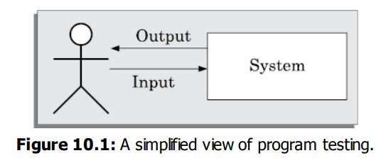
TESTING
The aim of program testing is to help realise and identify all defects in a program.
Basic Terminologies
A mistake is essentially any programmer action
that later shows up as an incorrect result during
program execution.
An error is the result of a mistake committed by a developer in any of the development activities.
A failure of a program essentially denotes an incorrect behaviour exhibited by the program during its execution.

Slide 14
TESTING
A test scenario is an abstract test case in the sense that it only identifies the aspects of the program that are to be tested without identifying the input, state, or output.
A test case can be said to be an implementation of a test scenario.
A test script is an encoding of a test case as a short program.
A test suite is the set of all test that have been designed by a tester to test a given program.
Testability of a requirement denotes the extent to which it is possible to determine whether an implementation of the requirement conforms to it in both functionality and performance.

Slide 15
TESTING
A test scenario is an abstract test case in the sense that it only identifies the aspects of the program that are to be tested without identifying the input, state, or output.
A test case can be said to be an implementation of a test scenario.
A test script is an encoding of a test case as a short program.
A test suite is the set of all test that have been designed by a tester to test a given program.
Testability of a requirement denotes the extent to which it is possible to determine whether an implementation of the requirement conforms to it in both functionality and performance.

Slide 16
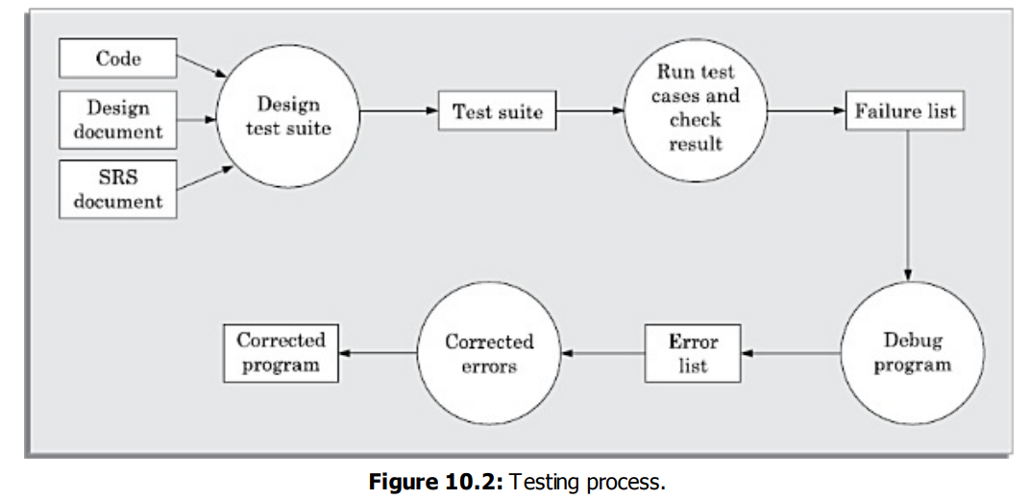
TESTING

Slide 17
BLACK-BOX TESTING
In black-box testing, test cases are designed from an examination of the input/output values only and no knowledge of design or code is required.
The following are the two main approaches available to design black box test cases:
Equivalence class partitioning
Boundary value analysis

Slide 18
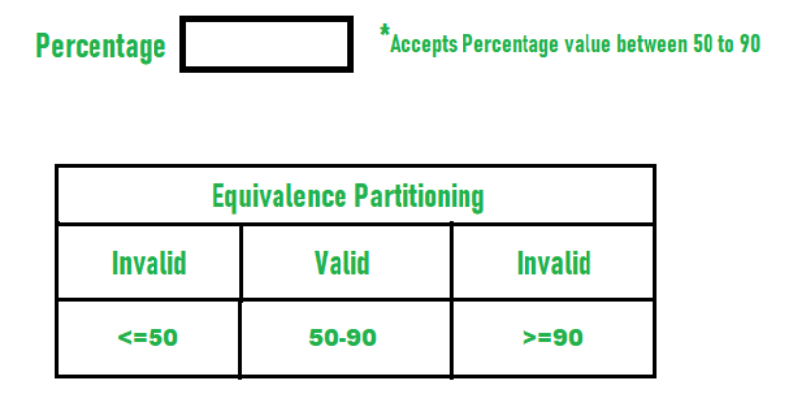
BLACK-BOX TESTING
Equivalence class partitioning
In the equivalence class partitioning approach, the domain of input values to the program under test is partitioned into a set of equivalence classes.
The partitioning is done such that for every input data belonging to the same equivalence class, the program behaves similarly
Example-1:
Let us consider an example of any college admission process. There is a college that gives admissions to students based upon their percentage.

Slide 19
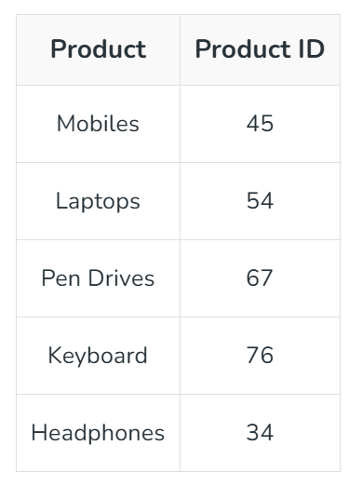
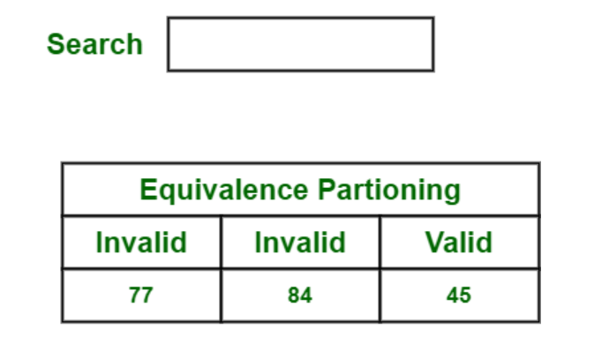
BLACK-BOX TESTING
Example-2:
Let us consider a set of products with product IDs and users wants to search for Mobiles. Below is a table of some products with their product Id.

Slide 20
BLACK-BOX TESTING
Boundary value analysis
A type of programming error that is frequently committed by programmers is missing out on the special consideration that should be given to the values at the boundaries of different equivalence classes of inputs.
For example, programmers may improperly use < instead of <=, or conversely <= for <, etc.

Slide 21
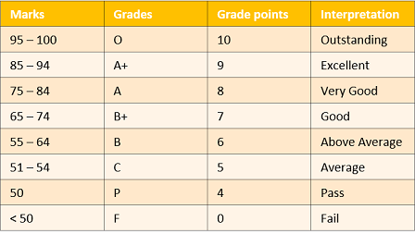
BLACK-BOX TESTING
Boundary value analysis

Slide 22
WHITE-BOX TESTING
White-box testing is an important type of unit testing.
One of the main benefits of white box testing is that it allows for testing every part of an application. To achieve complete code coverage, white box testing uses the following techniques:
Statement Coverage
Branch Coverage
Multiple condition coverage
Path Coverage (McCabe’s cyclomatic complexity metric)

Slide 23
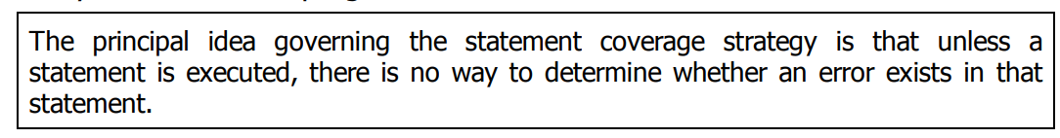
WHITE-BOX TESTING
Statement Coverage
The statement coverage strategy aims to design test cases so as to execute every statement in a program at least once.

Slide 24
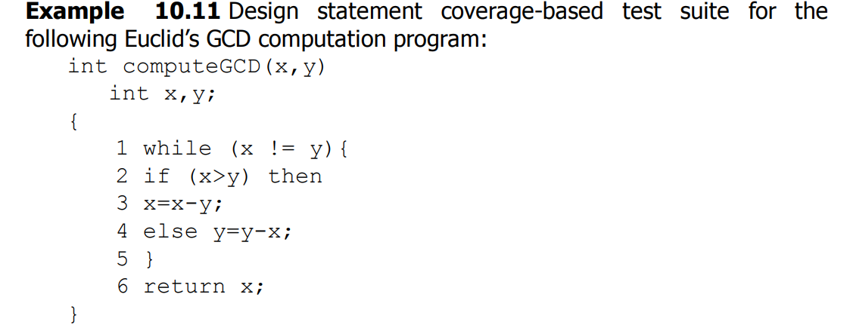
WHITE-BOX TESTING
Statement Coverage
By choosing the test set {(x = 3, y = 3), (x = 4, y = 3), (x = 3, y = 4)}, all statements of the program would be executed at least once.

Slide 25
WHITE-BOX TESTING
2. Branch Coverage
A test suite satisfies branch coverage, if it makes each branch condition in the program to assume true and false values in turn.
In other words, for branch coverage each branch in the CFG representation of the program must be taken at least once, when the test suite is executed.
Branch testing is also known as edge testing
if(x>2) x+=1;
The test suite would achieve statement coverage. However, it does not achieve branch coverage, since the condition (x > 2) is not made false by any test case in the suite.

Slide 26
WHITE-BOX TESTING
3. Multiple Condition Coverage
In the multiple condition (MC) coverage-based testing, test cases are designed to make each component of a composite conditional expression to assume both true and false values.
For a composite conditional expression of n components, 2n test cases are required for multiple condition coverage.
if(temperature>150 || temperature>50)
setWarningLightOn();
The program segment has a bug in the second component condition, it should have been temperature<50. The test suite {temperature=160, temperature=40} achieves branch coverage.
But, it is not able to check that setWarningLightOn(); should not be called for temperature values within 150 and 50.

Slide 27
WHITE-BOX TESTING
4. Path Coverage
A linearly independent path can be defined in terms of the control flow graph (CFG) of a program. Therefore, to understand path coverage-based testing strategy, we need to first understand how the CFG of a program can be drawn.
Control flow graph (CFG)
A CFG is a directed graph consisting of a set of nodes and edges (N, E), such that each node N corresponds to a unique program statement and an edge exists between two nodes if control can transfer from one node to the othe

Slide 28
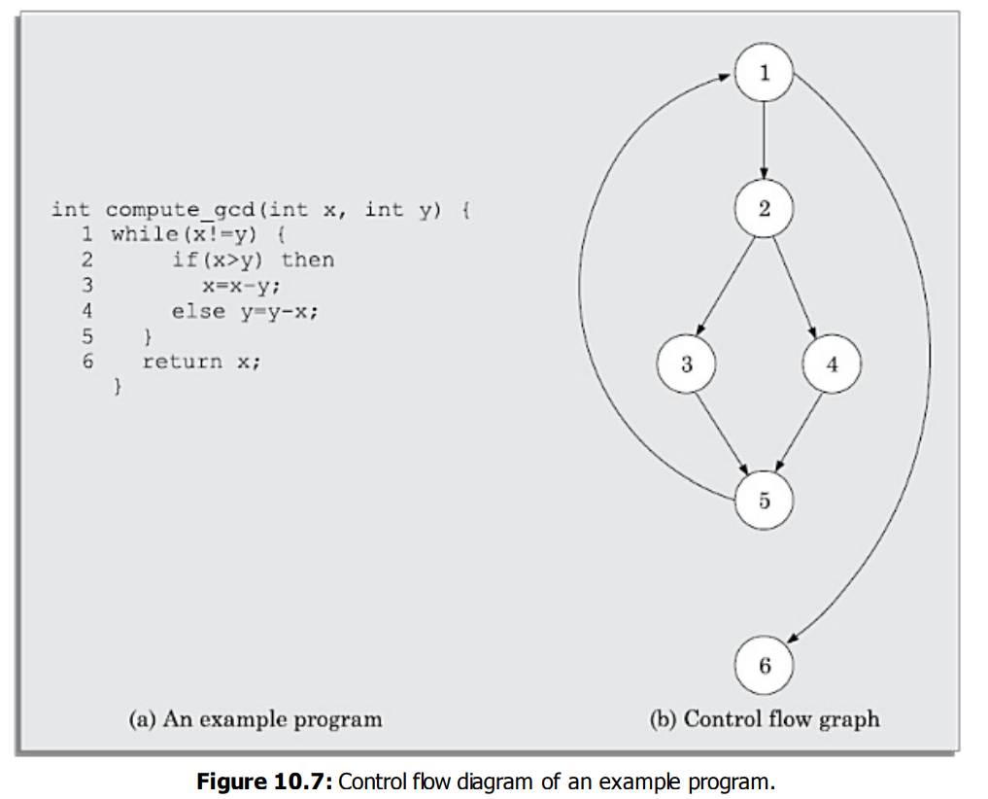
WHITE-BOX TESTING
4. Path Coverage
Control flow graph (CFG)
Calculate Linearly independent set of paths (or basis path set)

Slide 29
WHITE-BOX TESTING
4. Path Coverage
McCabe’s Cyclomatic Complexity Metric
Method 1: the cyclomatic complexity V(G) can be computed as
V(G) = E – N + 2
Method 2:
V(G) = Total number of non-overlapping bounded areas + 1
Method 3:
If N is the number of decision and loop statements of a program, then the McCabe’s metric is equal to N + 1

Slide 30
WHITE-BOX TESTING
4. Path Coverage
The following is the sequence of steps that need to be undertaken for deriving the path coverage-based test cases for a program:
1. Draw control flow graph for the program.
2. Determine the McCabe’s metric V(G).
3. Determine the cyclomatic complexity. This gives the minimum number of test cases required to achieve path coverage.
4. repeat

Slide 31
DEBUGGING
After a failure has been detected, it is necessary to first identify the program statement(s) that are in error and are responsible for the failure, the error can then be fixed.
Debugging Approaches
Brute force method: In this approach, print statements are inserted throughout the program to print the intermediate values with the hope that some of the printed values will help to identify the statement in error.
Backtracking: The source code is traced backwards until the error is discovered.

Slide 32
DEBUGGING
Debugging Approaches
Cause elimination method: once a failure is observed, the symptoms of the failure are noted. Based on the failure symptoms, the causes which could possibly have contributed to the symptom is developed and tests are conducted to eliminate each.
Program slicing
In the backtracking approach, one often has to examine a large number of statements.
Program slicing makes use of the fact that an error in the value of a variable can be caused by the statements on which it is data dependent.

Slide 33
PROGRAM ANALYSIS TOOLS
A program analysis tool usually is an automated tool that takes either the source code or the executable code of a program as input and produces reports regarding several important characteristics of the program, such as its size, complexity, adequacy of commenting, adherence to programming standards, adequacy of testing, etc.
Static analysis tools
Dynamic analysis tools

Slide 34
PROGRAM ANALYSIS TOOLS
Static Analysis Tools
Static program analysis tools assess and compute various characteristics of a program without executing it.
Typically, static analysis tools analyse the source code to compute certain metrics characterising the source code (such as size, cyclomatic complexity, etc.)
In this context, it displays the following analysis results:
To what extent the coding standards have been adhered to?
Whether certain programming errors such as uninitialised variables, mismatch between actual and formal parameters, variables that are declared but never used, etc., exist? A list of all such errors is displayed.
Code review techniques such as code walkthrough and code inspection can be considered as static analysis methods since those target to detect errors based on analysing.

Slide 35
PROGRAM ANALYSIS TOOLS
Dynamic Analysis Tools
Dynamic program analysis tools can be used to evaluate several program characteristics based on an analysis of the run time behaviour of a program.
A dynamic program analysis tool (also called a dynamic analyser ) usually collects execution trace information by instrumenting the code
Code instrumentation is usually achieved by inserting additional statements to print the values of certain variables into a file to collect the execution trace of the program.
The instrumented code when executed, records the behaviour of the software for different test cases.

Slide 36
INTEGRATION TESTING
The following approaches can be used to develop the test plan:
Big-bang approach to integration testing
Top-down approach to integration testing
Bottom-up approach to integration testing
Mixed (also called sandwiched ) approach to integration testing

Slide 37
INTEGRATION TESTING
Big-bang approach to integration testing
In this approach, all the modules making up a system are integrated in a single step.
In simple words, all the unit tested modules of the system are simply linked together and tested.
The main problem with this approach is that once a failure has been detected during integration testing, it is very difficult to localise the error as the error may potentially lie in any of the modules.
Therefore, debugging errors reported during big-bang integration testing are very expensive to fix.
As a result, big-bang integration testing is almost never used for large programs.

Slide 38
INTEGRATION TESTING
Bottom-up approach to integration testing
Large software products are often made up of several subsystems. A subsystem might consist of many modules which communicate among each other
In bottom-up integration testing, first the modules for the each subsystem are integrated.
The principal advantage of bottom- up integration testing is that several disjoint subsystems can be tested simultaneously.
Another advantage of bottom-up testing is that the low-level modules get tested thoroughly, since they are exercised in each integration step.
A disadvantage of bottom-up testing is the complexity that occurs when the system is made up of a large number of small subsystems that are at the same level. This extreme case corresponds to the big-bang approach.

Slide 39
INTEGRATION TESTING
Top-down approach to integration testing
Top-down integration testing starts with the root module in the structure chart and one or two subordinate modules of the root module.
After the top-level ‘skeleton’ has been tested, the modules that are at the immediately lower layer of the ‘skeleton’ are combined with it and tested.
A disadvantage of the top-down integration testing approach is that difficult to exercise the top-level module in the absence of lower level modules since lower level performs I/O operations.

Slide 40
INTEGRATION TESTING
Mixed approach to integration testing
The mixed (also called sandwiched ) integration testing follows a combination of top-down and bottom-up testing approaches.
In topdown approach, testing can start only after the top-level modules have been coded and unit tested. Similarly, bottom-up testing can start only after the bottom level modules are ready.
In the mixed testing approach, testing can start as and when modules become available after unit testing. Therefore, this is one of the most commonly used integration testing approaches.

Slide 41
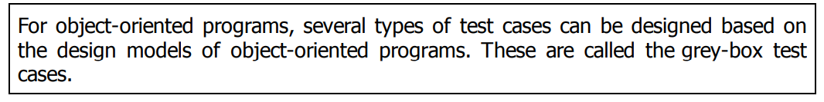
TESTING OBJECT-ORIENTED PROGRAMS
Thus, in an object oriented program, unit testing would mean testing each object in isolation.
During integration testing (called cluster testing in the object-oriented testing literature) various unit tested objects are integrated and tested.
Finally, system-level testing is carried out.

Slide 42
TESTING OBJECT-ORIENTED PROGRAMS
State-model-based testing (State coverage)
Use case-based testing (Scenario Coverage)
Class diagram-based testing (Derived classes)
Association testing (Relationships)
Aggregation testing (Aggregated objects)

Slide 43
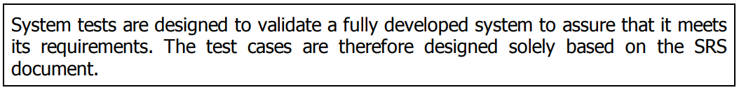
SYSTEM TESTING
Smoke Testing: Smoke testing is carried out before initiating system testing to ensure that system testing would be meaningful, The idea behind smoke testing is that if the integrated program cannot pass even the basic tests, it is not ready for a vigorous testing
Alpha Testing: Alpha testing refers to the system testing carried out by the test team within the developing organization.
Beta Testing: Beta testing is the system testing performed by a select group of friendly customers.
Acceptance Testing: Acceptance testing is the system testing performed by the customer to determine whether to accept the delivery of the system.

Slide 44
SYSTEM TESTING
5. Performance Testing: Performance testing is carried out to check whether the system meets the nonfunctional requirements identified in the SRS document.
Stress testing (short time period)
Volume testing (data structures – arrays, stacks etc)
Configuration testing (H/w and S/w Configurations)
Compatibility testing (Databases, servers, external systems/interfaces)
Regression testing (Enhance additional functionality)
Recovery testing (faults, or loss of power, devices, services, data, etc.)
Maintenance testing (Maintenance)
Documentation testing (user manual, maintenance manuals, and technical manuals)
Usability testing (User Interface requirements)
Security testing (Guarding confidential data)

Slide 45
SOME GENERAL ISSUES ASSOCIATED WITH TESTING
In this section, we shall discuss two general issues associated with testing. These are—how to document the results of testing and how to perform regression testing
Test documentation
A piece of documentation that is produced towards the end of testing is the test summary report.
It normally specifies the following:
What is the total number of tests that were applied to a subsystem.
Out of the total number of tests how many tests were successful.
How many were unsuccessful, and the degree to which they were unsuccessful,

Slide 46
SOME GENERAL ISSUES ASSOCIATED WITH TESTING
Regression testing
Regression testing spans unit, integration, and system testing.
Regression testing is the practice of running an old test suite after each change to the system or after each bug fix to ensure that no new bug has been introduced due to the change or the bug fix.
However, if only a few statements are changed, then the entire test suite need not be run — only those test cases that test the functions and are likely to be affected by the change need to be run.

Slide 47
SOFTWARE RELIABILITY AND
QUALITY MANAGEMENT
SOFTWARE RELIABILITY
The reliability of a software product essentially denotes its trustworthiness or dependability.
Alternatively, the reliability of a software product can also be defined as the probability of the product working “correctly” over a given period of time.
Users not only want the products they purchase to be highly reliable, but for certain categories of products they may even require a quantitative guarantee on the reliability of the product before making their buying decision.

Slide 48
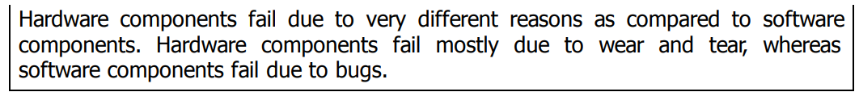
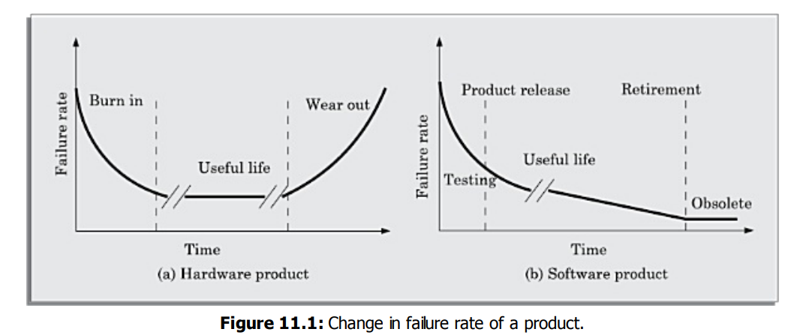
SOFTWARE RELIABILITY AND
QUALITY MANAGEMENT
SOFTWARE RELIABILITY
Hardware versus Software Reliability

Slide 49
SOFTWARE RELIABILITY AND
QUALITY MANAGEMENT
SOFTWARE RELIABILITY
ii) Reliability Metrics of Software Products
Rate of occurrence of failure (ROCOF) (ROCOF measures the frequency of occurrence of failures)
Mean time to failure (MTTF) (the time between two successive failures, averaged over a large number of failures)
Mean time to repair (MTTR) (MTTR measures the average time it takes to track the errors causing the failure and to fix them)
Mean time between failure (MTBF) (MTBF=MTTF+MTTR)
Probability of failure on demand (POFOD) (measures the likelihood of the system failing when a service request is made)
Availability (how likely would the system be available for use over a given period of time)

Slide 50
SOFTWARE RELIABILITY AND
QUALITY MANAGEMENT
STATISTICAL TESTING
Statistical testing is a testing process whose objective is to determine the reliability of the product rather than discovering errors.
To carry out statistical testing, we need to first define the operation profile of the product
Operation profile: Different categories of users may use a software product for very different purposes.
For example, a librarian might use the Library Automation Software to create member records, delete member records, add books to the library, etc., whereas a library member might use software to query about the availability of a book, and to issue and return books.
Formally, we can define the operation profile of a software as the probability of a user selecting the different functionalities of the software.

Slide 51
SOFTWARE RELIABILITY AND
QUALITY MANAGEMENT
STATISTICAL TESTING
The first step is to determine the operation profile of the software.
The next step is to generate a set of test data corresponding to the determined operation profile.
The third step is to apply the test cases to the software and record the time between each failure.
After a statistically significant number of failures have been observed, the reliability can be computed.

Slide 52
SOFTWARE RELIABILITY AND
QUALITY MANAGEMENT
SOFTWARE QUALITY
a good quality product does exactly what the users want it to do, since for almost every product, fitness of purpose is interpreted in terms of satisfaction of the requirements laid down in the SRS document
Unlike hardware products, software lasts a long time, in the sense that it keeps evolving to accommodate changed circumstances. The modern view of a quality associates with a software product several quality factors
Portability
Usability
Reusability
Correctness
Maintainability

Slide 53
SOFTWARE RELIABILITY AND
QUALITY MANAGEMENT
SOFTWARE QUALITY MANAGEMENT SYSTEM
A quality management system (often referred to as quality system) is the principal methodology used by organisations to ensure that the products they develop have the desired quality.
i) Managerial structure and individual responsibilities
every organisation has a separate quality department to perform several quality system activities.
Without support for the quality system at a high level in a company, few members of staff will take the quality system seriously

Slide 54
SOFTWARE RELIABILITY AND
QUALITY MANAGEMENT
SOFTWARE QUALITY MANAGEMENT SYSTEM
ii) Quality system activities
The quality system activities encompass the following:
Auditing of projects to check if the processes are being followed.
Collect process and product metrics and analyse them to check if quality goals are being met.
Review of the quality system to make it more effective.
Development of standards, procedures, and guidelines.
Produce reports for the top management summarising the effectiveness of the quality system in the organisation.

Slide 55
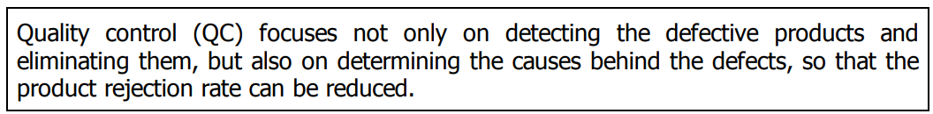
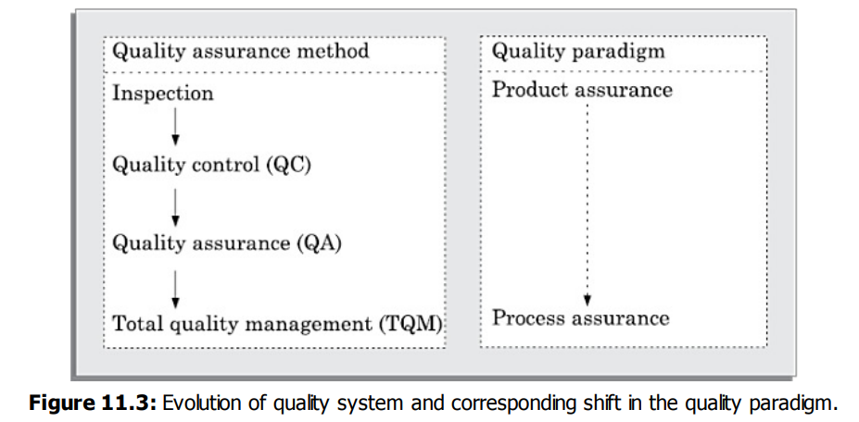
SOFTWARE RELIABILITY AND
QUALITY MANAGEMENT
SOFTWARE QUALITY MANAGEMENT SYSTEM
iii) Evolution of Quality Systems

Slide 56
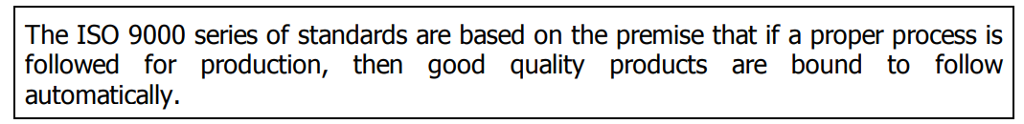
SOFTWARE RELIABILITY AND
QUALITY MANAGEMENT
ISO 9000
International organisation for Standardization (ISO) is a consortium of 63 countries established to formulate and foster standardisation. ISO published its 9000 series of standards in 1987.
The ISO 9000 standard specifies the guidelines for maintaining a quality system
In a nutshell, ISO 9000 specifies a set of recommendations for repeatable and high quality product development.
ISO 9000 is a series of three standards—ISO 9001, ISO 9002, and ISO 9003

Slide 57
SOFTWARE RELIABILITY AND
QUALITY MANAGEMENT
ISO 9000
ISO 9001: This standard applies to the organisations engaged in design, development, production, and servicing of goods. This is the standard that is applicable to most software development organisations.
ISO 9002: This standard applies to those organisations which do not design products but are only involved in production. Examples of this category of industries include steel and car manufacturing industries who buy the product and plant designs from external sources and are involved in only manufacturing those products. Therefore, ISO 9002 is not applicable to software development organisations.
ISO 9003: This standard applies to organisations involved only in installation and testing of products.

Slide 58
SOFTWARE RELIABILITY AND QUALITY MANAGEMENT
ISO 9000
The ISO 9000 registration process consists of the following stages:
Application stage: Once an organisation decides to go for ISO 9000 certification, it applies to a registrar for registration.
Pre-assessment: During this stage the registrar makes a rough assessment of the organisation.
Document review and adequacy audit: During this stage, the registrar reviews the documents submitted by the organisation and makes suggestions for possible improvements.
Compliance audit: During this stage, the registrar checks whether the suggestions made by it during review have been complied to by the organisation or not.
Registration: The registrar awards the ISO 9000 certificate after successful completion of all previous phases.
Continued surveillance: The registrar continues monitoring the organisation periodically.

Slide 59
SOFTWARE RELIABILITY AND QUALITY MANAGEMENT
ISO 9000
The ISO 9000 registration process consists of the following stages:
Application stage: Once an organisation decides to go for ISO 9000 certification, it applies to a registrar for registration.
Pre-assessment: During this stage the registrar makes a rough assessment of the organisation.
Document review and adequacy audit: During this stage, the registrar reviews the documents submitted by the organisation and makes suggestions for possible improvements.
Compliance audit: During this stage, the registrar checks whether the suggestions made by it during review have been complied to by the organisation or not.
Registration: The registrar awards the ISO 9000 certificate after successful completion of all previous phases.
Continued surveillance: The registrar continues monitoring the organisation periodically.

Slide 60
SOFTWARE RELIABILITY AND QUALITY MANAGEMENT
ISO 9000

Slide 61
SOFTWARE RELIABILITY AND QUALITY MANAGEMENT
SEI CAPABILITY MATURITY MODEL
SEI capability maturity model (SEI CMM) was proposed by Software Engineering Institute of the Carnegie Mellon University, USA.
The Unites States Department of Defence (US DoD) is the largest buyer of software product. It often faced difficulties in vendor performances, and had to many times live with low quality products, late delivery, and cost escalations.
In this context, SEI CMM was originally developed to assist the U.S. Department of Defense (DoD) in software acquisition
In simple words, CMM is a reference model for apprising the software process maturity into different levels. This can be used to predict the most likely outcome to be expected from the next project that the organisation undertakes.

Slide 62
SOFTWARE RELIABILITY AND QUALITY MANAGEMENT
SEI CAPABILITY MATURITY MODEL
It must be remembered that SEI CMM can be used in two ways— capability evaluation and software process assessment.
SEI CMM classifies software development industries into the following five maturity levels:
Level 1: Initial A software development organisation at this level is characterised by adhoc activities.
Since software production processes are not defined, different engineers follow their own process and as a result development efforts become chaotic.

Slide 63
SOFTWARE RELIABILITY AND QUALITY MANAGEMENT
SEI CAPABILITY MATURITY MODEL
Level 2: Repeatable
At this level, the basic project management practices such as tracking cost and schedule are established.
Configuration management tools are used on items identified for configuration control.
Size and cost estimation techniques such as function point analysis, COCOMO, etc., are used. The

Slide 64
SOFTWARE RELIABILITY AND QUALITY MANAGEMENT
SEI CAPABILITY MATURITY MODEL
Level 3: Defined
At this level, the processes for both management and development activities are defined and documented. There is a common organisation-wide understanding of activities, roles, and responsibilities.
ISO 9000 aims at achieving this level.
Level 4: Managed
At this level, the focus is on software metrics. Both process and product metrics are collected. Quantitative quality goals are set for the products and at the time of completion of development it was checked whether the quantitative quality goals for the product are met.

Slide 65
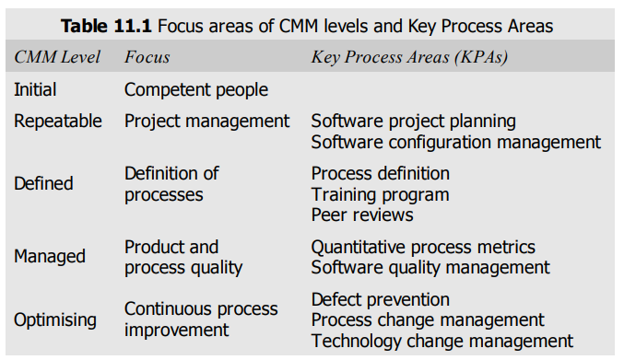
SOFTWARE RELIABILITY AND QUALITY MANAGEMENT
SEI CAPABILITY MATURITY MODEL
Level 5: Optimising
At this stage, process and product metrics are collected. Process and product measurement data are analysed for continuous process improvement.

